Slide 1

NovaCode

Slide 2
Table of contents
Our Game
The Creators
Our Time
Technologies

Slide 3
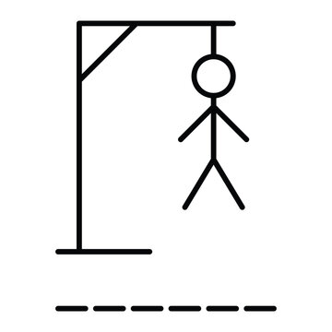
Our game
We have created a simple HangMan game. Its an easy word‑guessing game where players are given empty spaces for letters where they have to gues what letters to put in the spaces to form a word. It’s a relaxing game with which people can both chill and compete with eatchother.

Slide 4




The creators
Scrum Trainer – Ангел Фриедериш
BackEnd Developer – Георги Христов
FrontEnd Developer – Димитър Янакиев
Designer – Виктор Георгиев

Slide 5
Our time spent
Week 1
Week 2
Week 3

Slide 6





Technologies Used

Slide 7
Lets get to the game!
Thanks for the attention!

